Slide 1
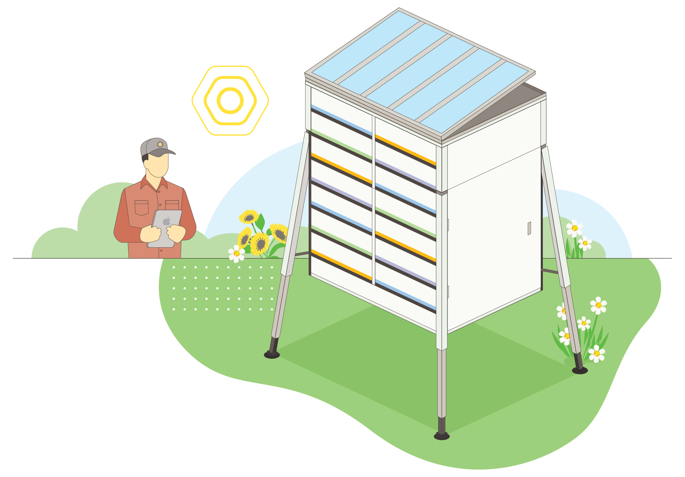
Smart Beehive Monitoring System
By:
Jasmeet Singh Matta
Jaouaher Belgacem
By

Slide 2

MOTIVATION

Slide 3
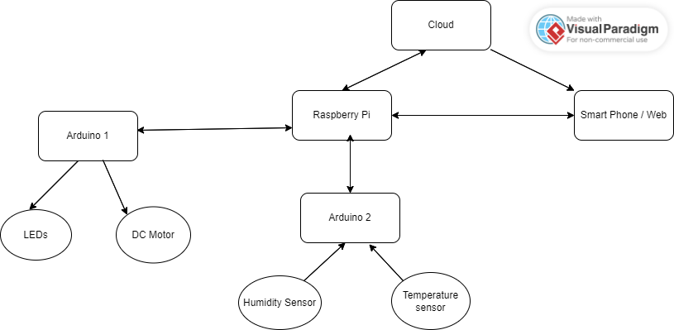
System’s Concept
Block Diagram

Slide 4
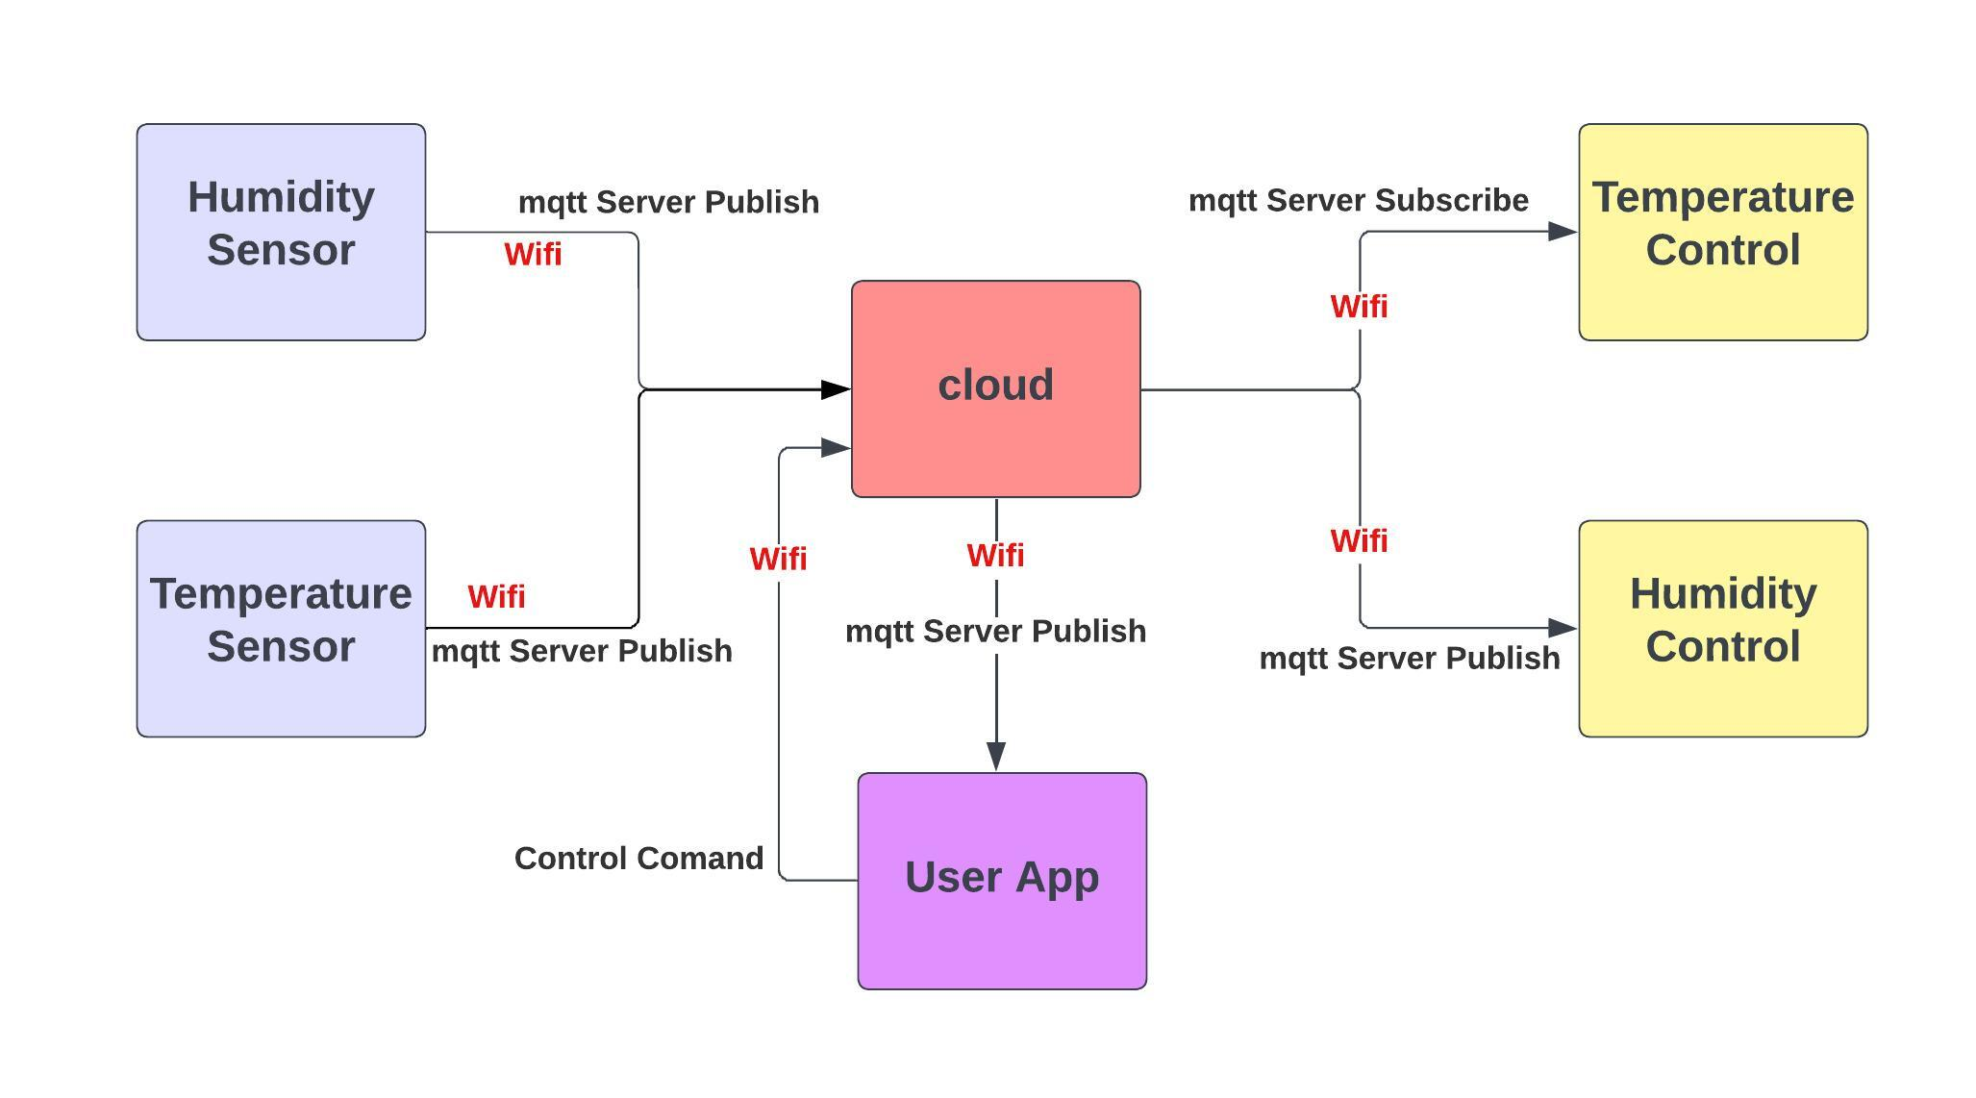
System’s Concept
Block Diagram

Slide 5
Used Hardware and Software
Hardware :
1 x RGB LED Actuator
1 X Humidity/Temperature Sensor
1 x DC Motor
1 X Raspberry Pi
2 X Microcontrollers: Arduino Uno Wifi R2
1 X SmartPhone
Software :
Raspberry Pi: Central station
Arduino IDE
Mqtt mobile application
Cloud

Slide 6
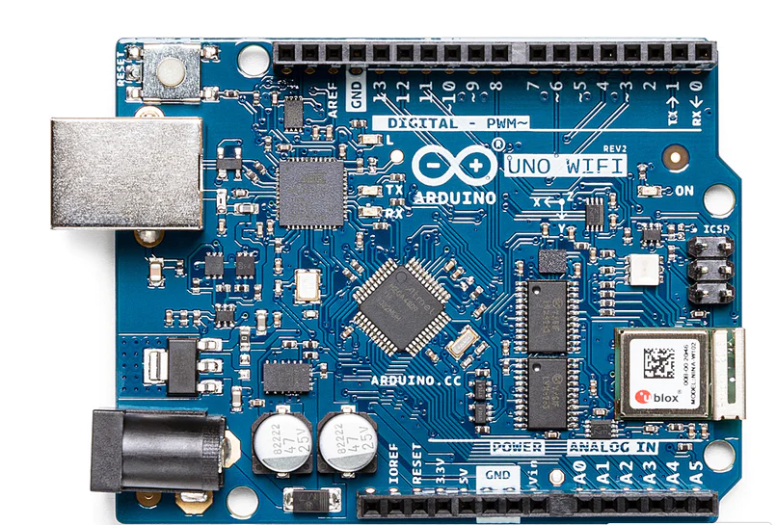
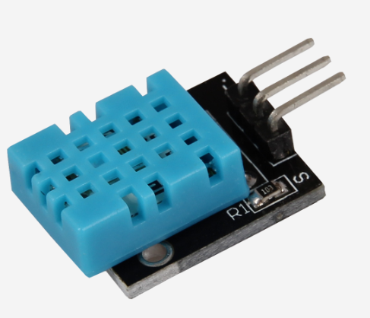
Parts of system
Publisher (sensor unit)
+

Slide 7
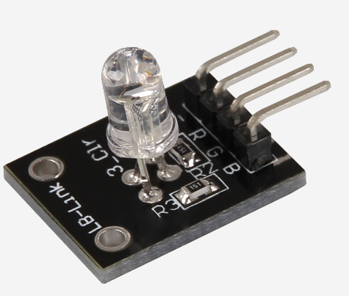

Parts of system
Subscriber (Actuators unit)
+

Slide 8
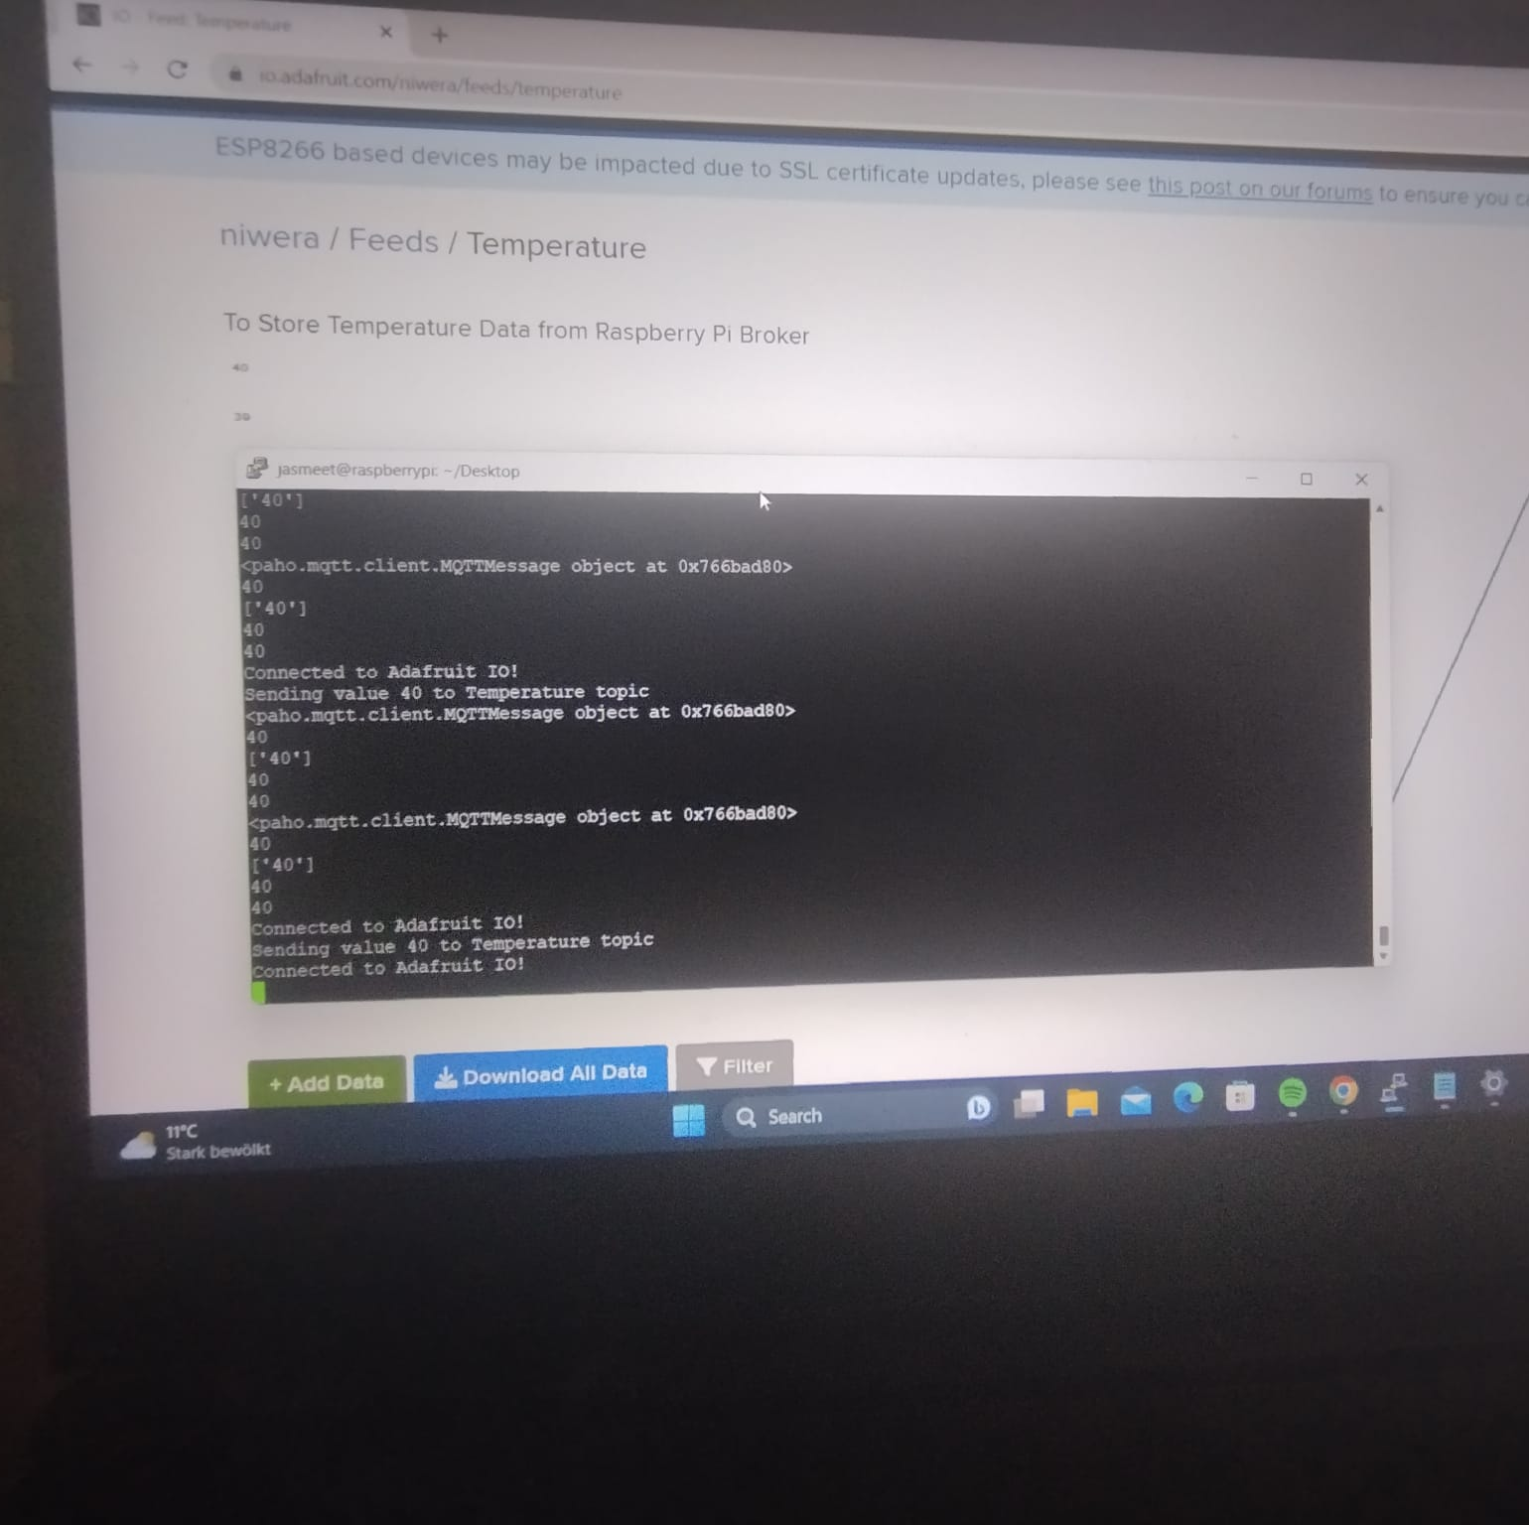
Parts of system
Cloud

Slide 9
REAL Time Testing of the System

Slide 10
Thank you

